Slide 1
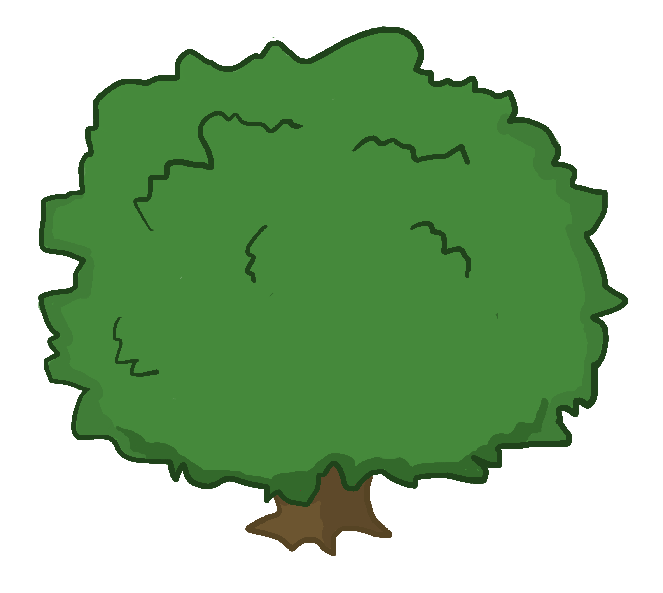
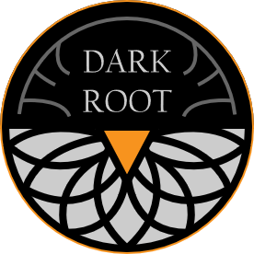
Carrot Quest The Root of Evil
STYLE GUIDE

Slide 2
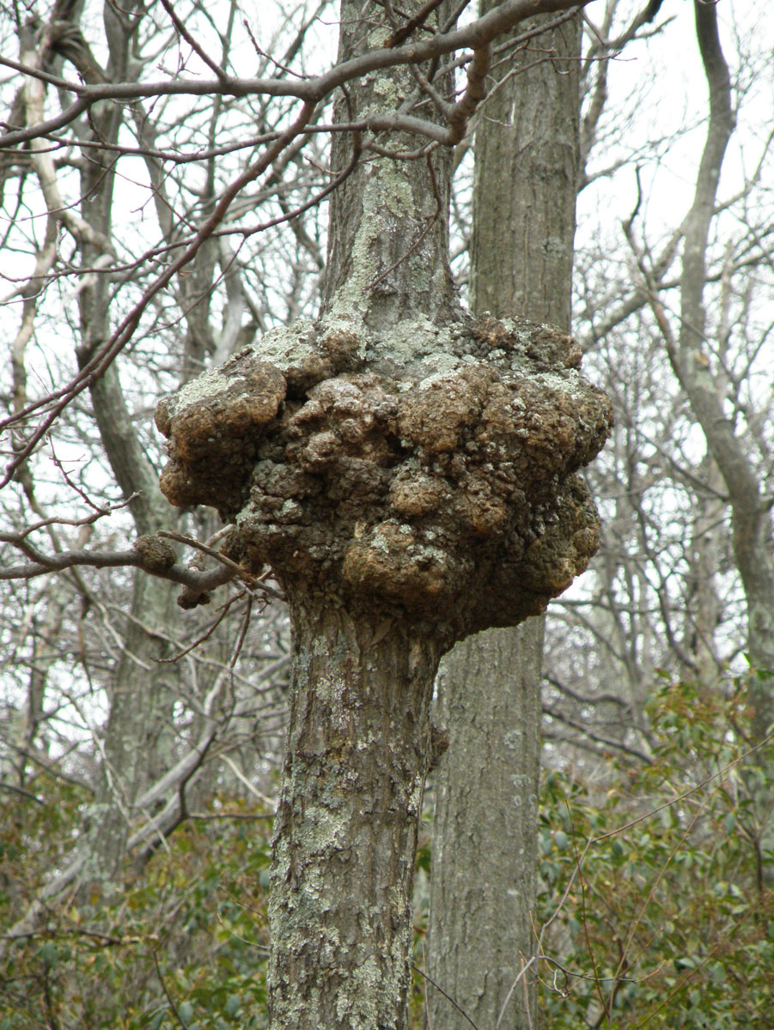
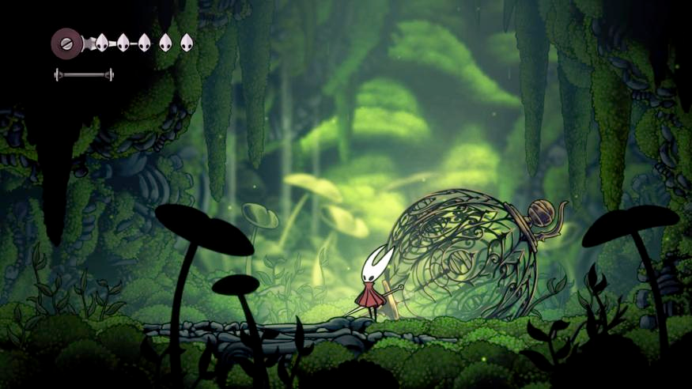
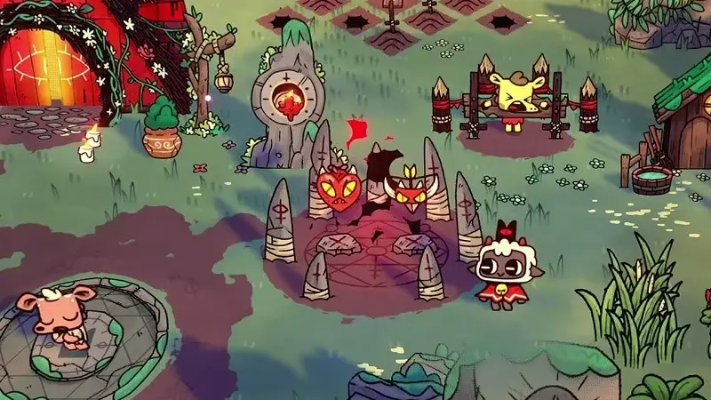
WORLD
A nature filled world with darkness and corruption lurking behind the corners. A variety of natural environments: forests, grasslands, arctic, desert, catacombs, etc.
Corruption affects the whole land, with certain areas filled to the brim. Corruption creates unsustainable growth, tumorous. Mix of decaying flesh and plant life within the environment.
Hollow Knight style lineart and cell shading, enhanced with painterly elements

Slide 3
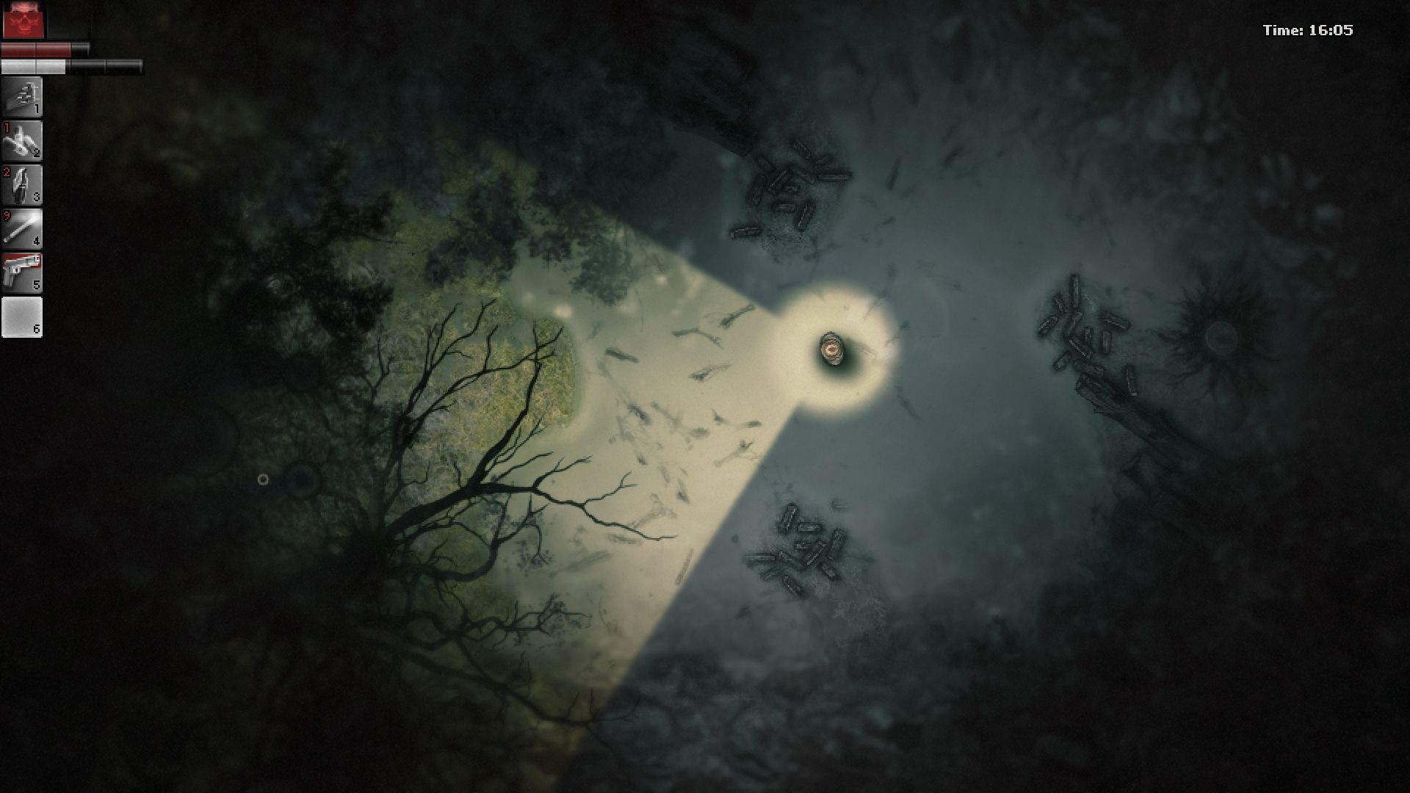
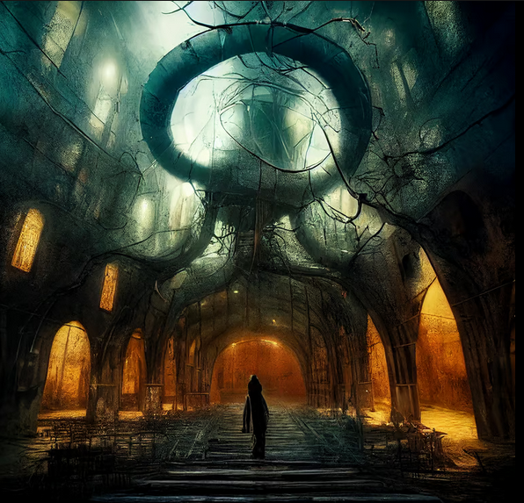
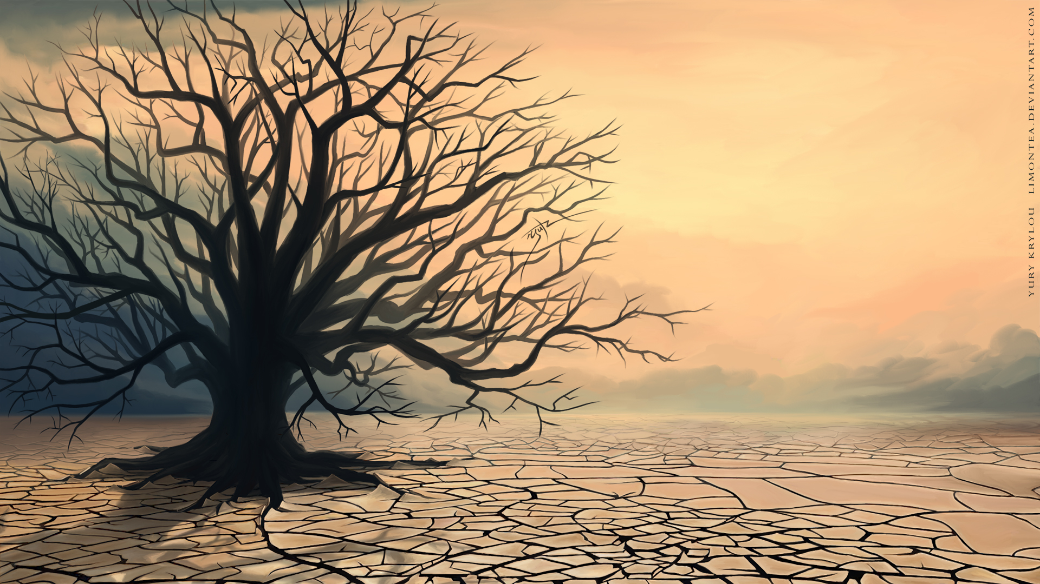
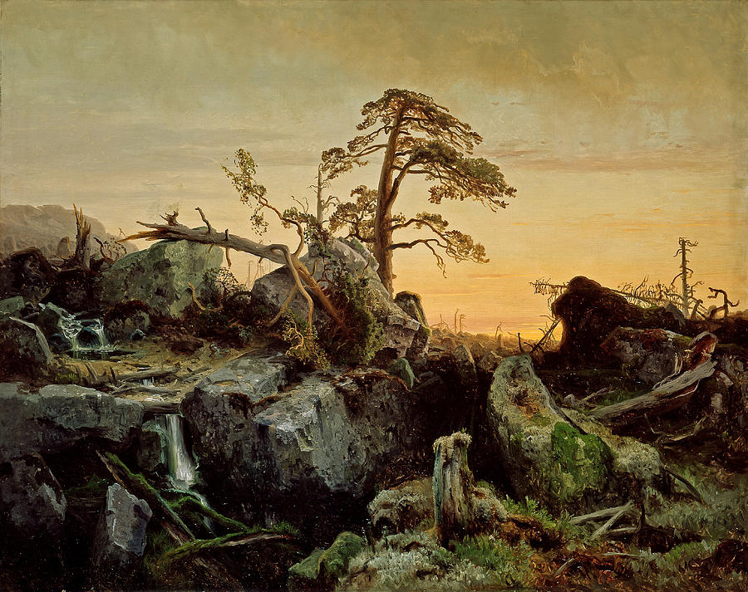
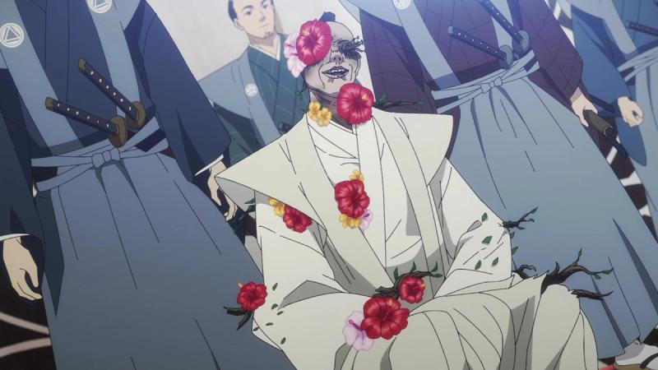
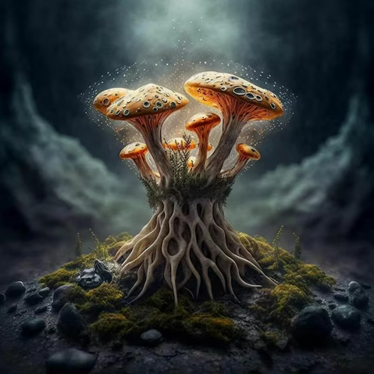
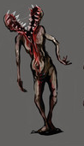
ENVIRONMENT FEEL/THEMES
Reflects the natural world, with evidence of decay and corruption.
Both darkness and color coexist. A natural environment mixed with patches of decaying nature. Like a green field, that has patches of dead weeds.
The beautiful elements of an environment combined with the horrific, to create contrast.

Slide 4
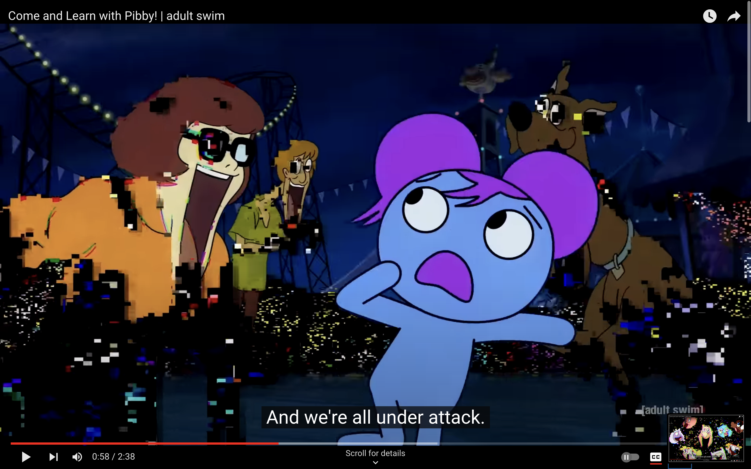
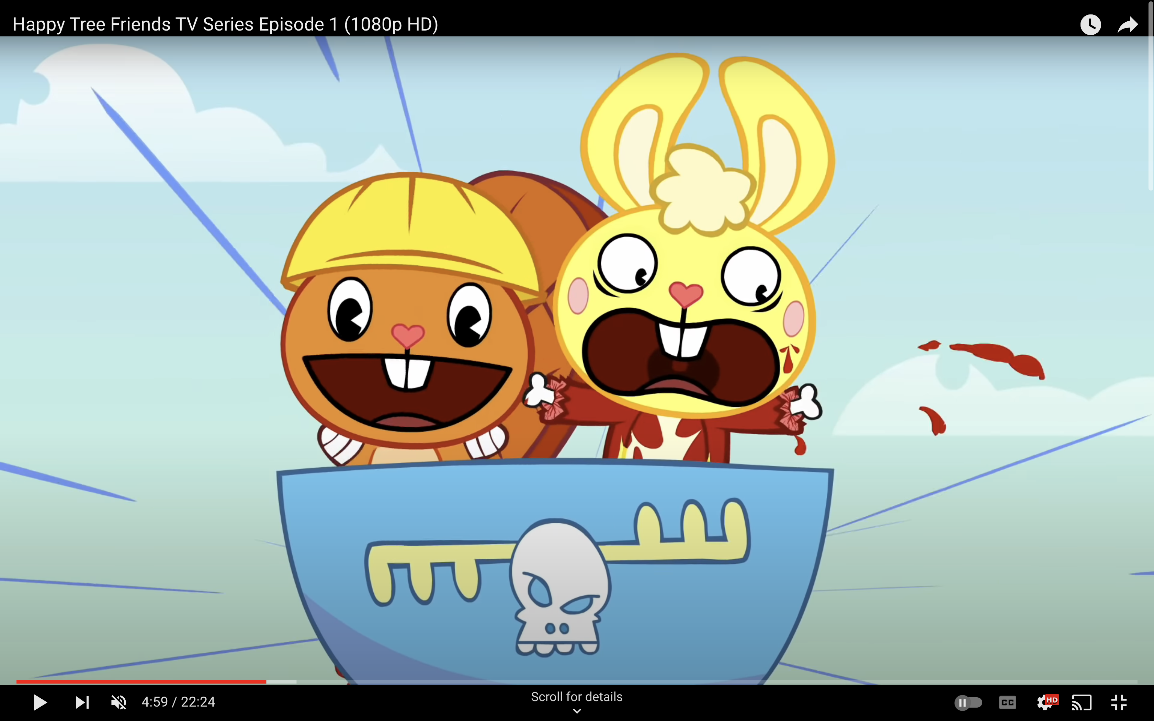
Game Feel
While the game initially has a soft and sweet demeanor you should always be on your guard in Bunnyville. The curse has affected not just the townsfolk, but the land as well. Every step is a deeper plunge into darkness.
The game is meant to have a very innocence that is being corrupted. As seen with Happy Tree friends in the bottom right hand corner. Things appear cute and cuddly, but get quite horrifying. (Not nearly as much blood as Happy Tree Friends)

Slide 5
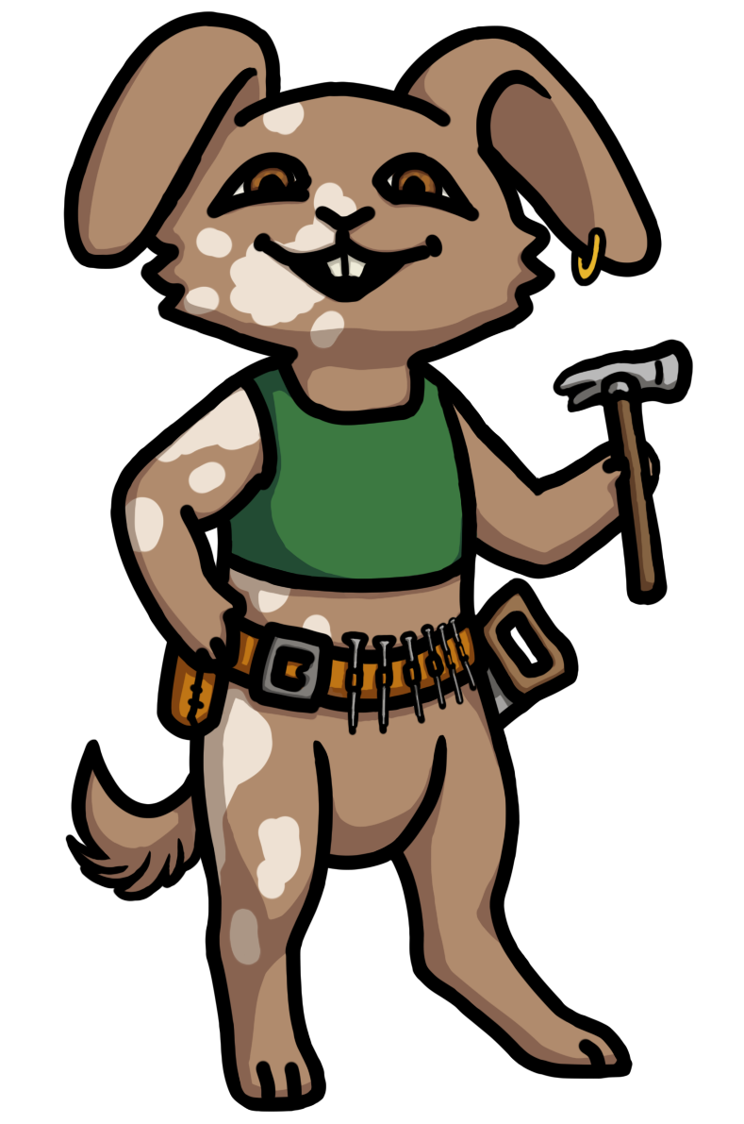
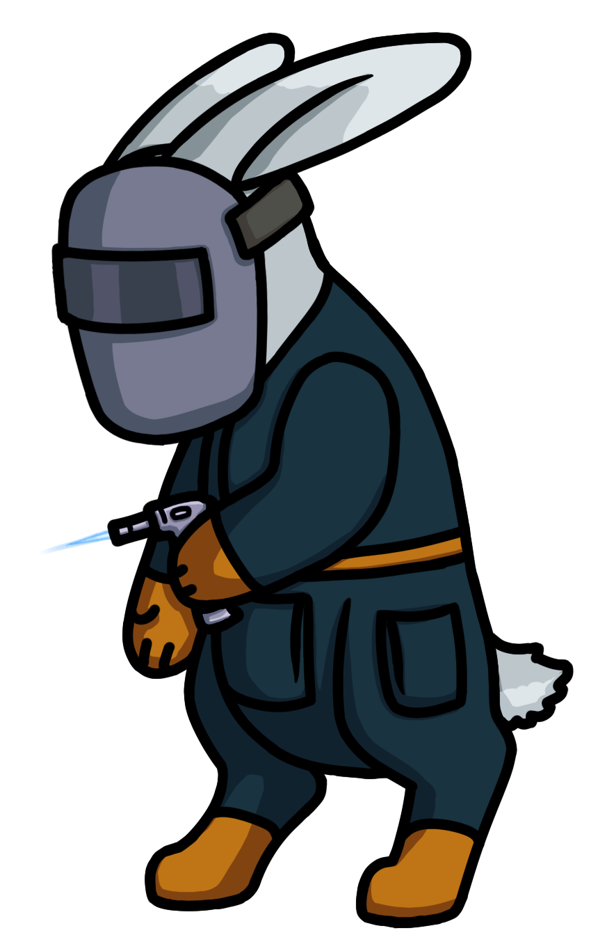
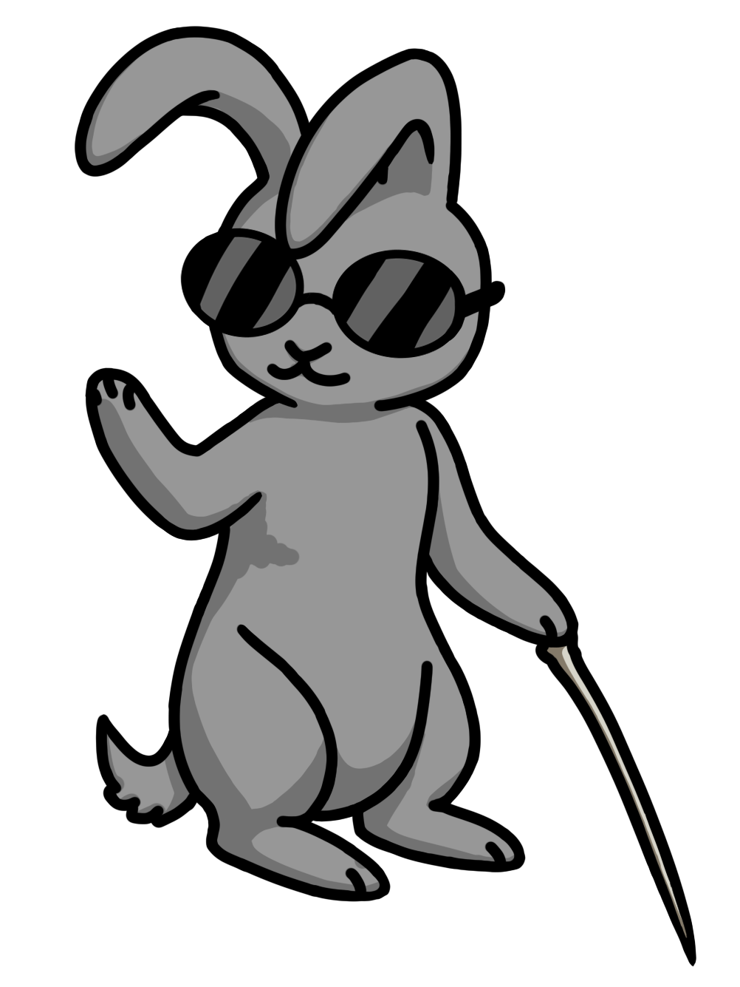

CHARACTERS
Upright, confident pose and smile shows Oakly’s cheerful and capable personality
Slightly turned away, a bit hunched. Shows Dewdrop’s more nervous personality.
Black outlines over cell shaded art
Bunnyville bunnies are friendly and look soft
A character’s idle pose should reflect their personality

Slide 6
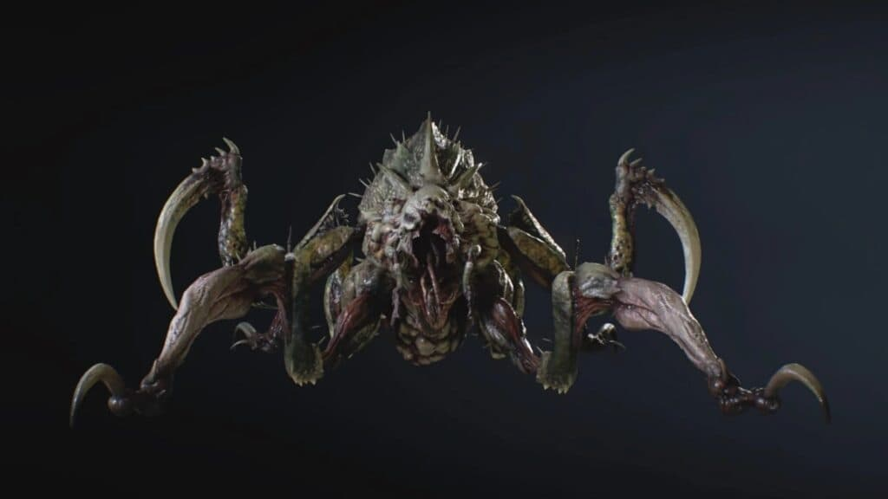
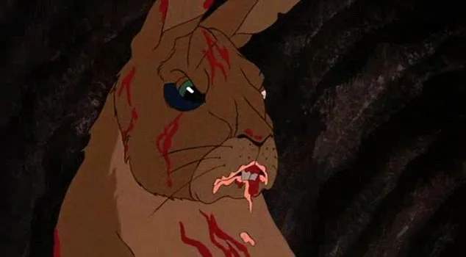
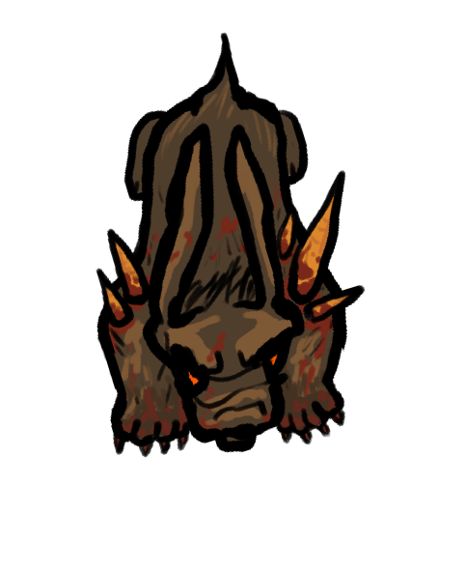
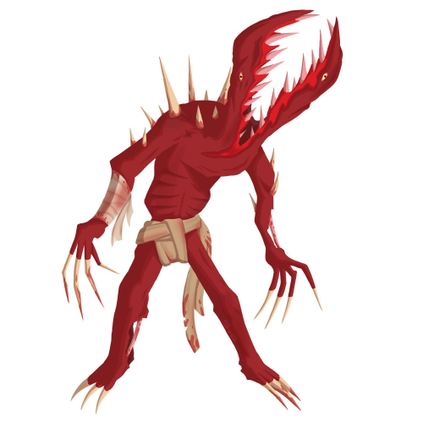
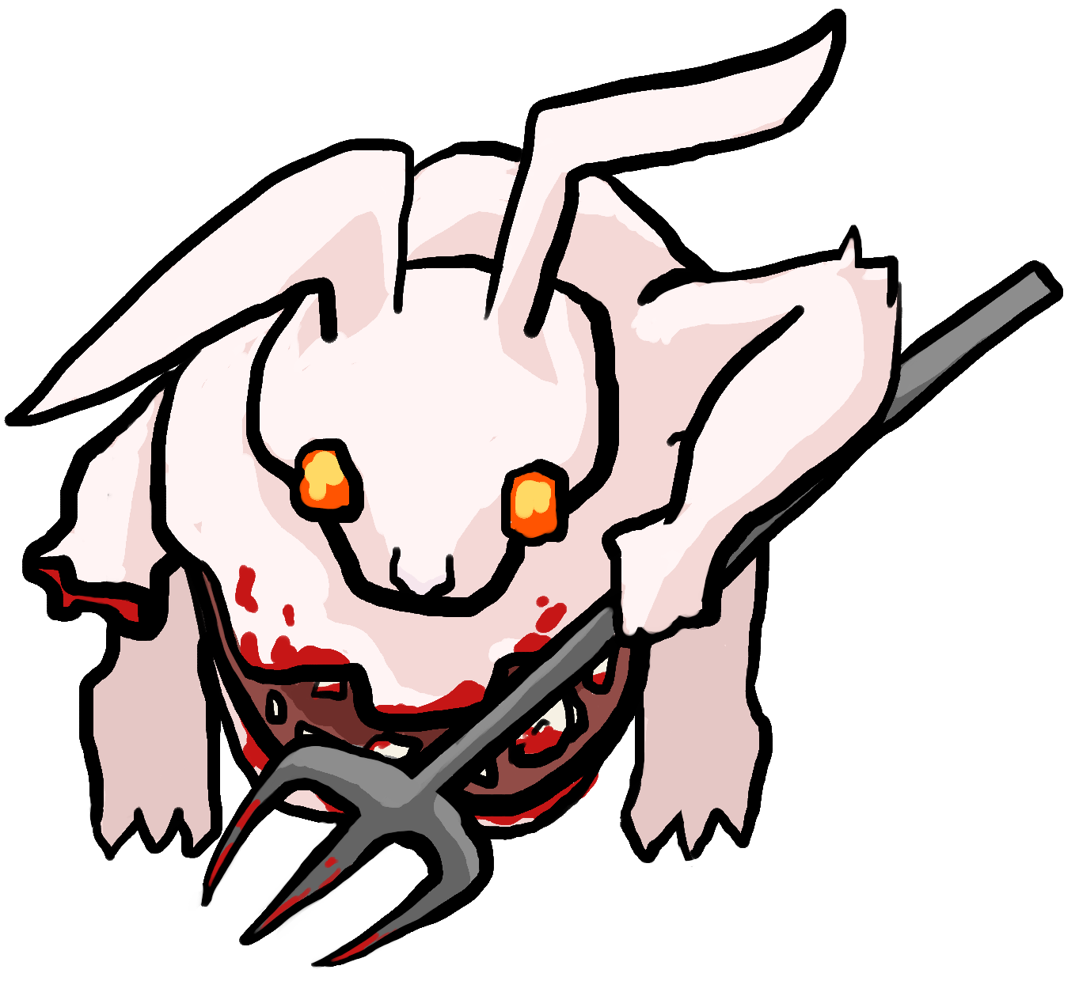
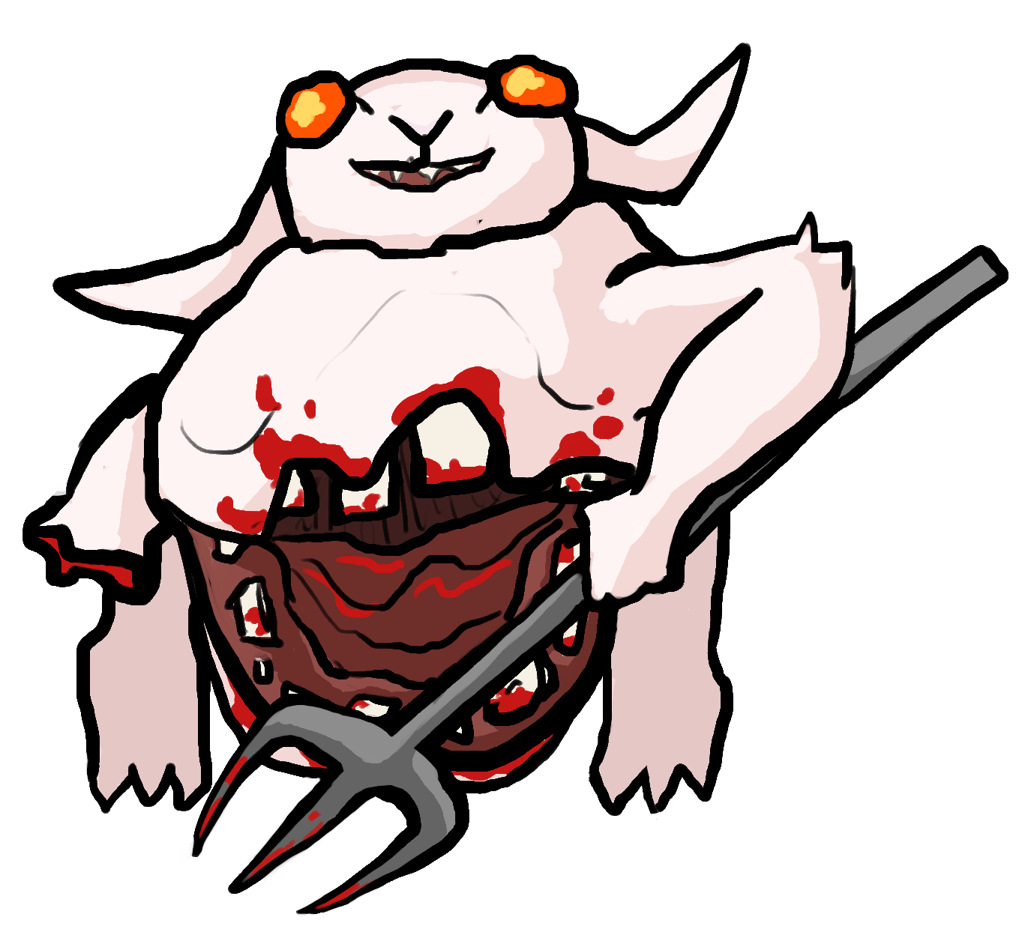
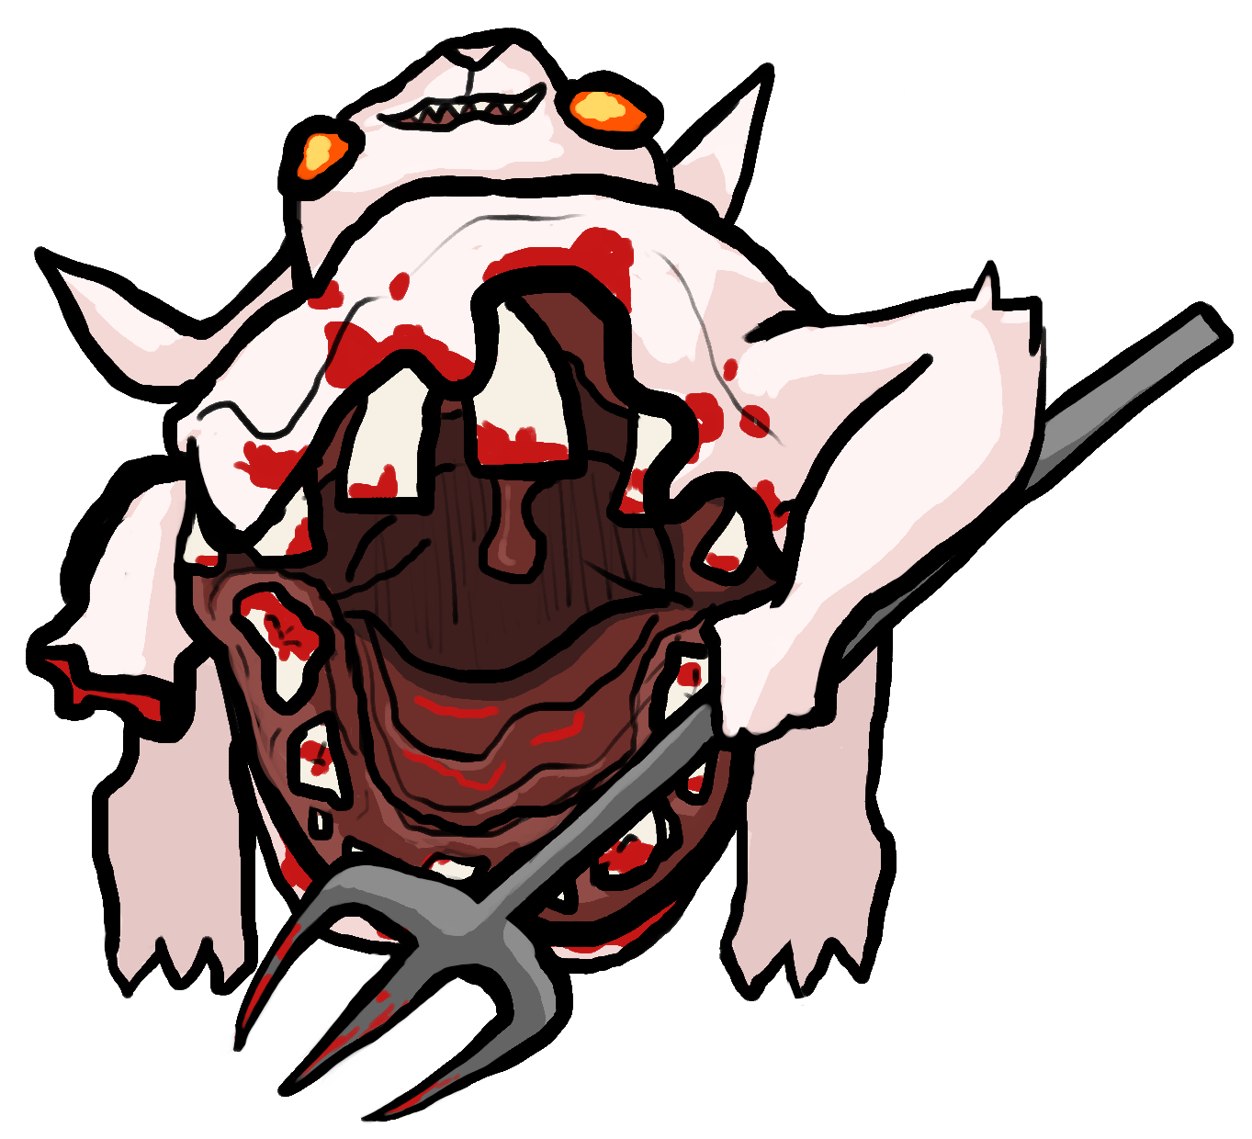
ENEMIES
Carrots growing out show the horror of the Carrot Curse
Black outlines over cell shaded art
Enemies mutated by the Carrot Curse are often zombie-like, with blood or warped bodies
Carrots often feature in the designs, as if they are growing through the cursed enemies
Enemies should have unique mutations reflecting their attack style and environment
Large mouth reflects massive melee attack style, and distinctive roar to summon allies

Slide 7
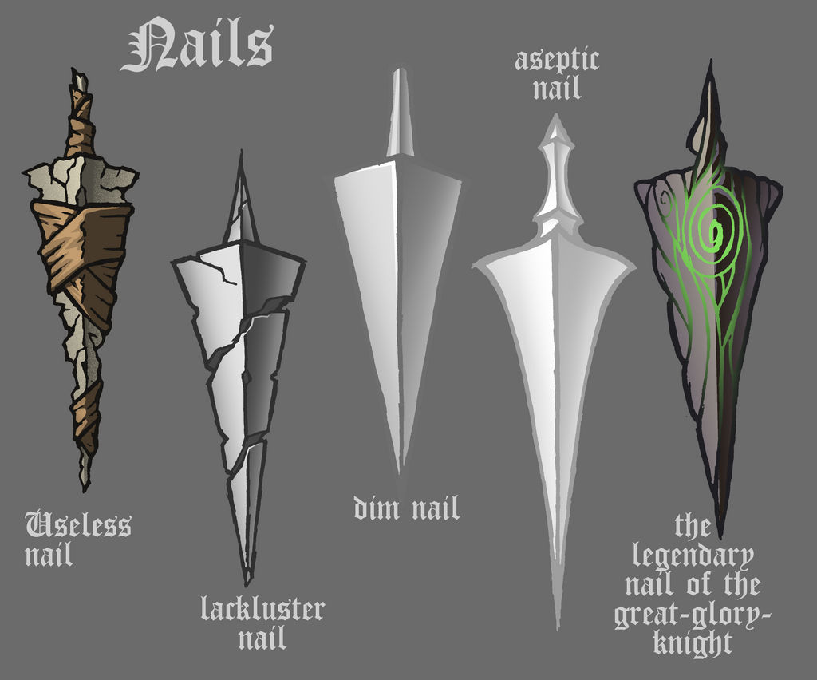

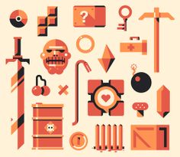
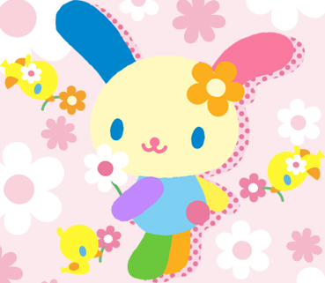
OBJECTS
Communicate the uniqueness of the item, while keeping the design simple
The currency, Carrot Seeds, is a simple rotating triangle
Other dropped items have black outlines and are cell-shaded, or have simple gradients
Items can either have a rough, sharp dreary style like the useless nail, or they can be colorful and bright like you would find in Hello Kitty. Ignore the color palette of this example and focus on style.
Powerups will not be outlined, to better enhance their unique visuals

Slide 8
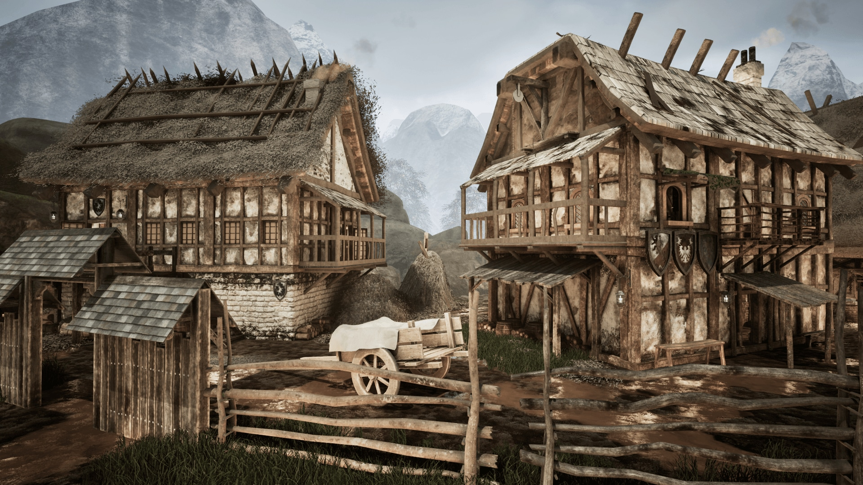
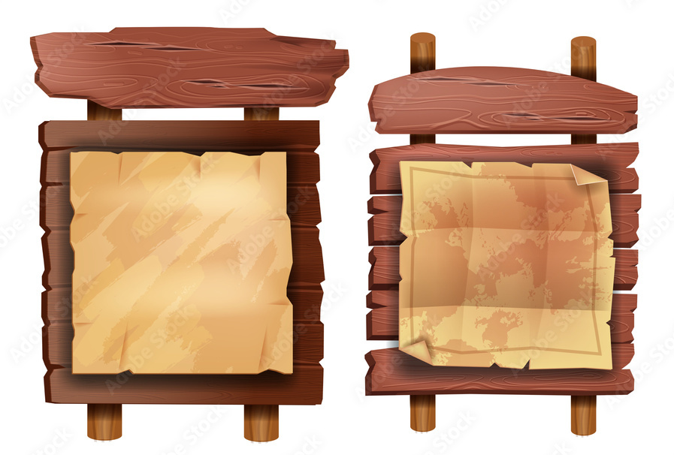
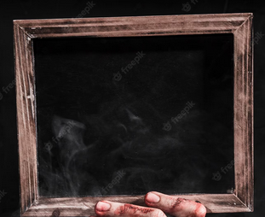
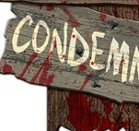
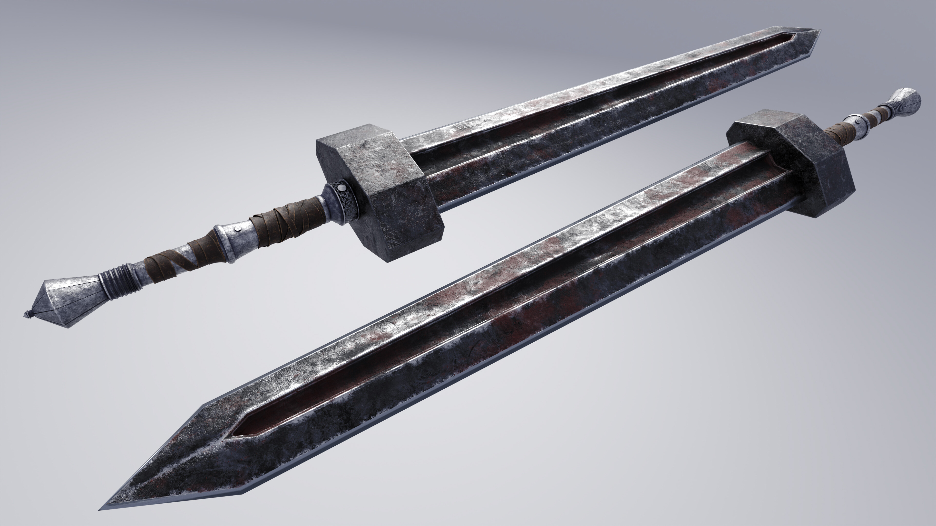
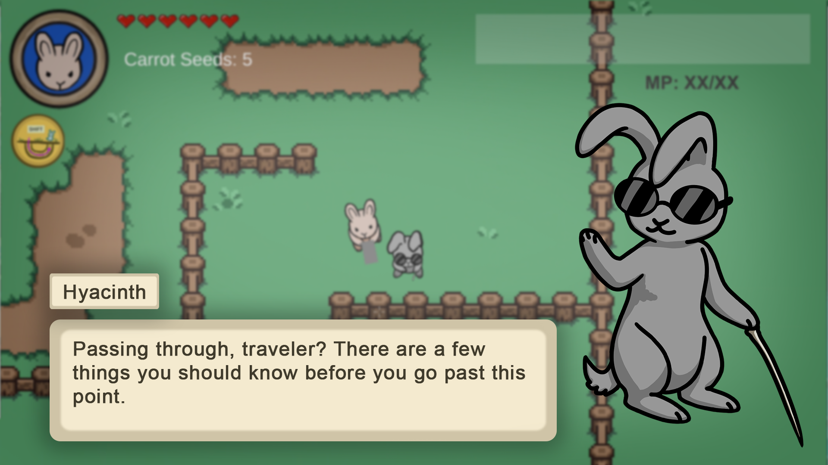
UI
Matching with the general aesthetics of the game, the UI will be outlined in black, or a dark brown
UI should feel “village rustic” with some rust and blood thrown in to show corruption. The blood will be subtle, on the corners, not overt as in the picture.

Slide 9
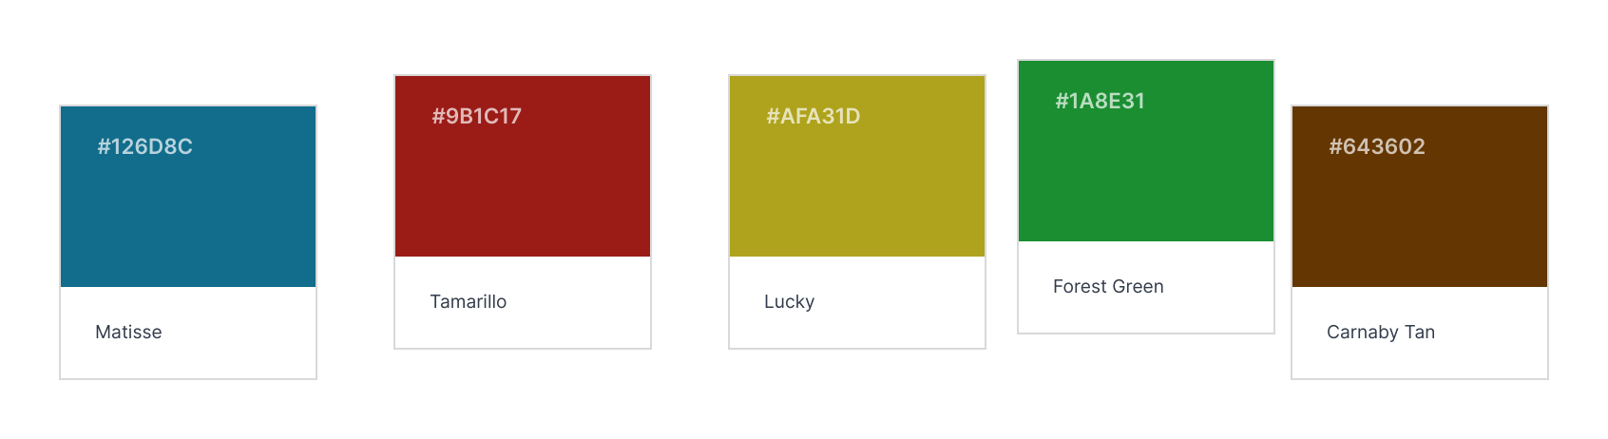
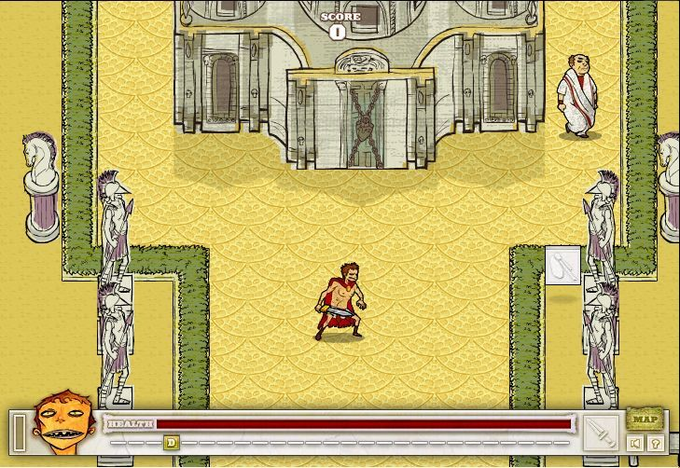
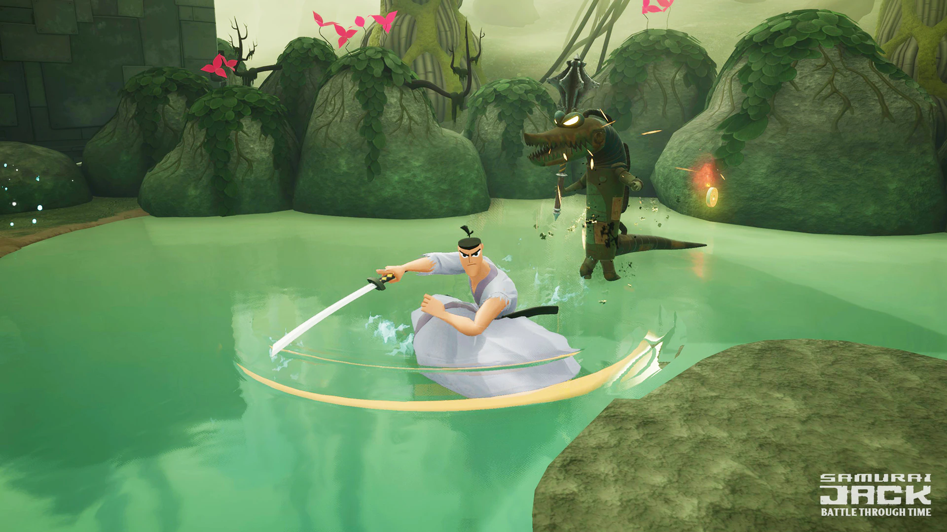
Color Palette
The color palette is similar to Adventure time, but a lot more muted color. A variety of colors, but none too cheery

